Slide 1

Suite of care pathway templates
“Co-funded by the European Union. Views and opinions expressed are however those of the author(s) only and do not necessarily reflect those of the European Union or European Health and Digital Executive Agency. Neither the European Union nor the granting authority can be held responsible for them.”

Slide 2
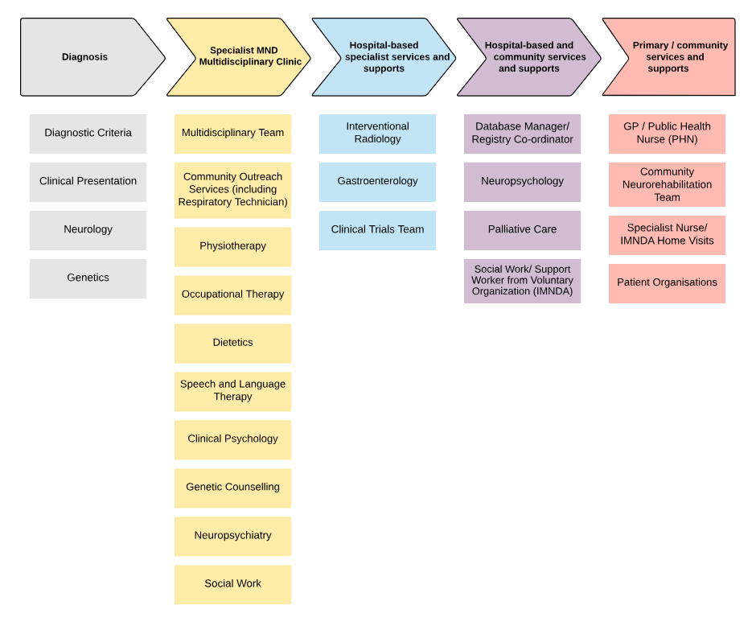
Example 1: HSE Irish care pathway for Amyotrophic Lateral Sclerosis (ALS) using Lucid Chart
Notes:
In Ireland we have used a Lucid chart image as a landing page for each of our national care pathways. Here is an example of the ALS landing page. The structure can be flexible but each pathway starts with a diagnosis column which includes the appropriate diagnostic criteria, clinical presentation and disciplines involved in diagnosis. This is followed by care sections which capture the disciplines and interventions required at specialist, hospital, shared and primary/community care level. In ALS there is specialist MND MDT clinic so the model can be flexible depending on how care is delivered.

Slide 3
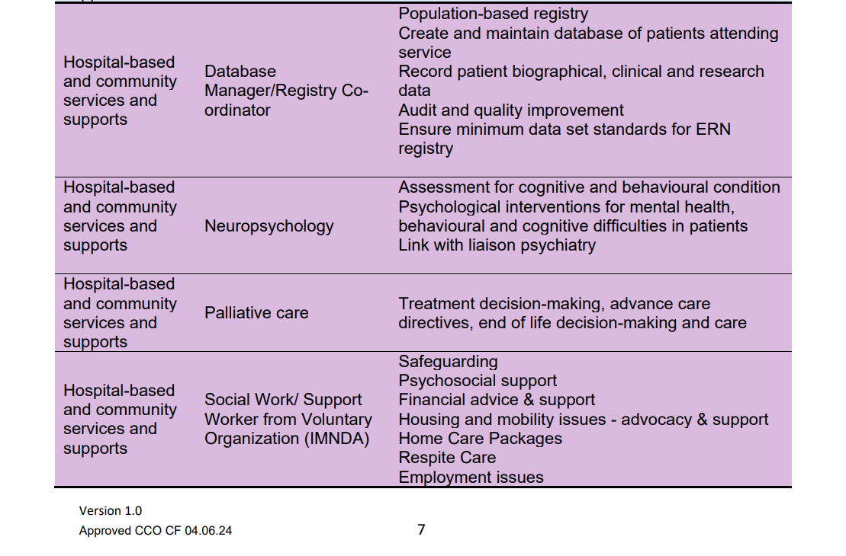
Each section can be populated with detailed content https://www.hse.ie/eng/services/list/5/rarediseases/care-pathways/als-care-pathway.pdf
Notes:
More detailed content is behind each section.

Slide 4
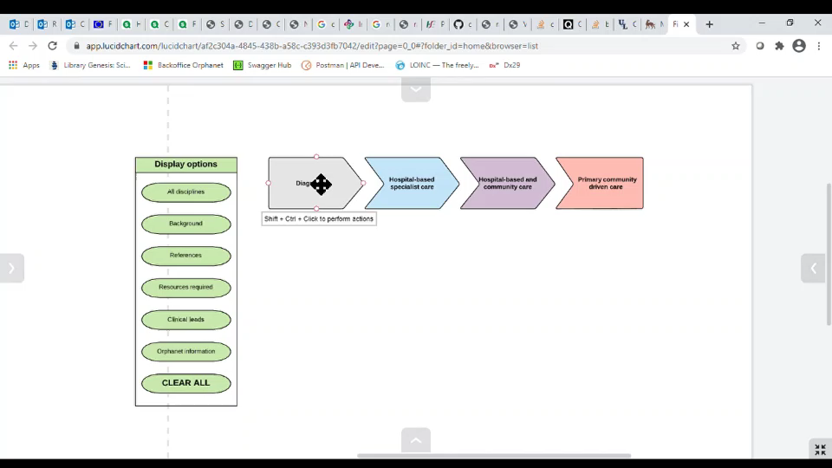
Interactive
Notes:
This can be interactive with more detailed content accessible by clicking on the individual tiles so that users can click through to the relevant section of interest. By clicking through the graphic the user can access the more detailed information within e.g. the Diagnosis section which includes diagnostic criteria, clinical presentation, disciplines involved in diagnosis with the investigations, lab blood and genetic tests.

Slide 5
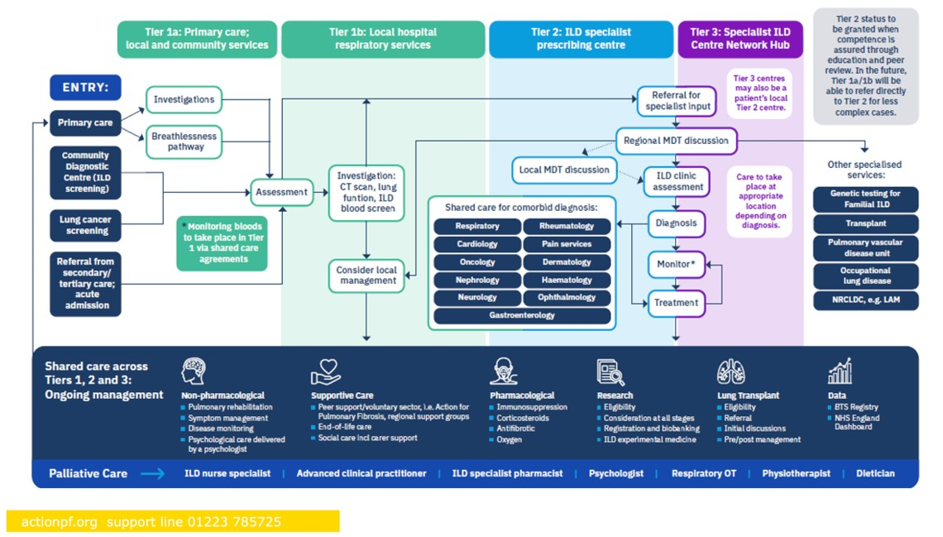
Example 2: Interstitial Lung Disease Care Pathway by
Action for Pulmonary Fibrosis UK
Notes:
Here is an example of the ILD. It is algorithmic with clear entry and exit points. It includes services at primary, community, local hospital and specialist level. There is a shared care section which captures aspects of ongoing management, for pharmacological and non-pharmacological, surgical and supportive care and research.

Slide 6
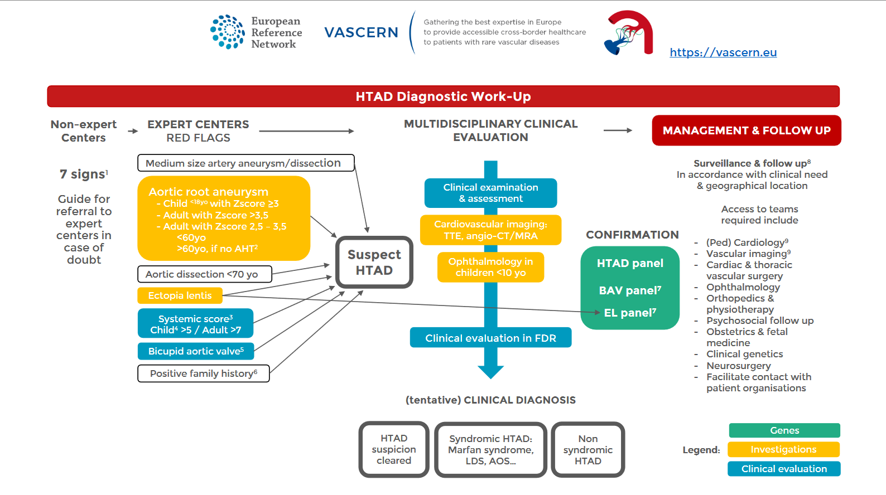
Example 3: VASCERN patient pathway – HTAD
Notes:
VascERN have also developed a number of care pathways called ‘patient pathways’ which show red flags for referral from local to expert centre, details of the clinical evaluation, investigations and genomic testing involved in the diagnostic work-up and a very high-level view of relevant disciplines for management and follow-up. It will need to be considered by pathway development groups early on in the process. We would be interested to hear your thoughts on this?

Slide 7
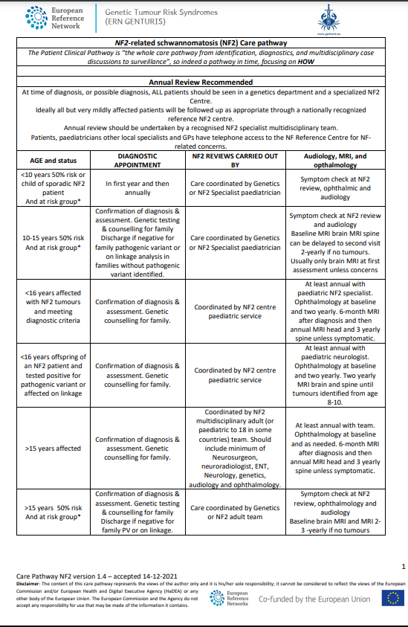
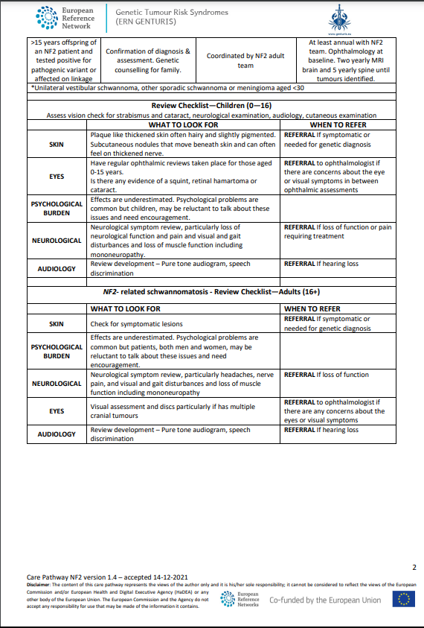
Example 4: ERN GENTURIS care pathway – NF2
https://www.genturis.eu/l=eng/Assets/20211214_ERN_GENTURIS_Care_Pathway_NF2_v1.4_accepted_disclaimer_new-nomenclature.pdf
Notes:
ERN GENTURIS have developed care pathways for a number of conditions with a tabular format. Here is an example for NF2 which captures the follow-up what, when and who.

Slide 8
Example 1: HSE Irish care pathway for Amyotrophic Lateral Sclerosis (ALS) using Lucid Chart
Hardiman O, Van Den Berg LH, Kiernan MC. Clinical diagnosis and management of amyotrophic lateral sclerosis. Nature reviews neurology. 2011 Nov;7(11):639-49.
National Institute for Health and Care Excellence. Overview: Motor neurone disease: Assessment and management: Guidance [Internet]. NICE. 2019 [cited 2023Feb4]. Available from: www.nice.org.uk/guidance/ng42
Notes:
In Ireland we have used a Lucid chart image as a landing page for each of our national care pathways. Here is an example of the ALS landing page. The structure can be flexible but each pathway starts with a diagnosis column which includes the appropriate diagnostic criteria, clinical presentation and disciplines involved in diagnosis. This is followed by care sections which capture the disciplines and interventions required at specialist, hospital, shared and primary/community care level. In ALS there is specialist MND MDT clinic so the model can be flexible depending on how care is delivered.

Slide 9
Each section can be populated with detailed content https://www.hse.ie/eng/services/list/5/rarediseases/care-pathways/als-care-pathway.pdf
Notes:
More detailed content is behind each section.

Slide 10
Example 2: Interstitial Lung Disease Care Pathway by
Action for Pulmonary Fibrosis UK
Notes:
Here is an example of the ILD. It is algorithmic with clear entry and exit points. It includes services at primary, community, local hospital and specialist level. There is a shared care section which captures aspects of ongoing management, for pharmacological and non-pharmacological, surgical and supportive care and research.

Slide 11
Example 3: VASCERN patient pathway – HTAD
Notes:
VascERN have also developed a number of care pathways called ‘patient pathways’ which show red flags for referral from local to expert centre, details of the clinical evaluation, investigations and genomic testing involved in the diagnostic work-up and a very high-level view of relevant disciplines for management and follow-up. It will need to be considered by pathway development groups early on in the process. We would be interested to hear your thoughts on this?

Slide 12
Example 4: ERN GENTURIS care pathway – NF2
https://www.genturis.eu/l=eng/Assets/20211214_ERN_GENTURIS_Care_Pathway_NF2_v1.4_accepted_disclaimer_new-nomenclature.pdf
Notes:
ERN GENTURIS have developed care pathways for a number of conditions with a tabular format. Here is an example for NF2 which captures the follow-up what, when and who.

Slide 13

© 2024 JARDIN Joint Action on integration of ERNs into national healthcare systems| EU4H-2022-JA2-IBA-05 | 101129863

